Slide 1
VIRTUAL ASSISTANT
USING PYTHON
DONE BY,
AKASH DANIEL. P

Slide 2
Introduction
A virtual assistant implemented using Python is a software application designed program to assist users with various tasks, provide information, and automate certain processes using machine learning, and other techniques.
It can interacts with users through text-based or voice-based interfaces.
Users can ask questions, give commands, or request assistance with specific tasks.
Depending on its capabilities, the virtual assistant can perform a wide range of tasks including, Providing information, Task automation, Controlling devices, Personalized assistance.
Overall, a virtual assistant combines various technologies and algorithms to create an intelligent and interactive system capable of assisting users in a wide range of tasks and scenarios.

Slide 3
IMPLEMETATION OF VIRTUAL ASSISTANT

Slide 4
These are the implementation present in this Code:
IMPORTING THE MODULES
SPEAK
LISTEN
COMMANDS
EXECUTION

Slide 5
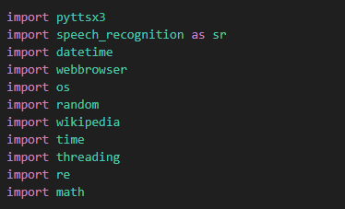
IMPORTING THE MODULES
These are the Modules which was imported in this Code.

Slide 6
Pyttsx3 : “pyttsx3” is a Python library that provides a cross-platform interface for text-to-speech (TTS) synthesis. It allows developers to generate speech from text in Python scripts. The "3" in pyttsx3 denotes that it is the third version of the library
Speech-Recognition : “speech-recognition” is a Python library that provides speech recognition functionality to Python applications. It allows to integrate speech recognition capabilities into their programs, enabling them to convert spoken language into text.
Datetime : “datetime” is a module that provides classes and functions for working with dates and times. It allows developers to manipulate dates, times, and time intervals, perform arithmetic operations on dates, format date and time strings, and handle time zones.
Webbrowser : ”webbrowser” is a built-in module that provides a high-level interface for displaying web-based documents to users. It allows to interact with web browsers installed on the system and open URLs, web pages, or files in the default web browser.
Os : "os" module provides a way to interact with the operating system in a platform-independent manner. It offers a wide range of functions for performing operating system-related tasks, such as file and directory manipulation, process management, environment variables, etc,.

Slide 7
Random : ”random” module is a built-in module that provides functions for generating pseudo-random numbers. It offers a wide range of functions for generating random numbers, selecting random elements from sequences, shuffling sequences randomly, and more.
Wikipedia : “Wikipedia” module provides a convenient interface for accessing and querying Wikipedia articles programmatically. It allows developers to retrieve content from Wikipedia pages, search for articles, get summaries, extract sections, and more, all through the Python programming language.
Time : “time” module is a built-in module that provides functions for working with time-related tasks. It offers various functionalities for measuring time, pausing execution, converting between different time representations, and more.
Threading : ”threading” module is a built-in module that provides a high-level interface for working with threads in a multithreaded environment. Threading allows you to run multiple tasks concurrently within a single process, enabling you to execute multiple pieces of code simultaneously and efficiently utilize system resources.
Math : ”math” module is a built-in module that provides mathematical functions and constants for performing various mathematical operations.

Slide 8
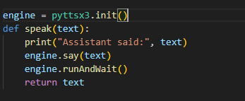
2. SPEAK()
The Speak() Function is to speak the given text and return the text
The “engine = pyttsx3.init()”
initializes the text-to-speech (TTS) engine provided by the pyttsx3 library in Python.

Slide 9
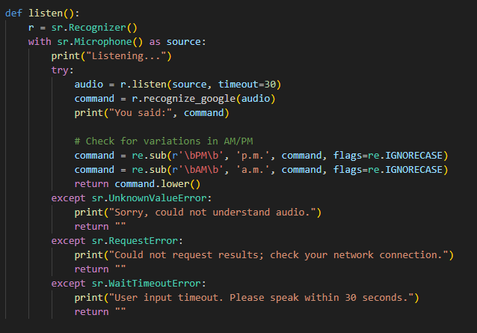
3. LISTEN()
This Function is to recognize speech which was spoken by the user.

Slide 10
4. COMMANDS
There are Various Commands that are used in this program are,
Greetings such as “Hi”, ”Hello”, ”Hey”, "good morning", "good afternoon", "good evening"
Time
Set Alarm
Stopwatch
Open Website
Play Music
Calculation
Query
Object Detection
News
Weather
Translate
Exit

Slide 11
ADVANTAGES
Convenience
Task Automation
Personalization
Hands Free Operation
Multifunctonality

Slide 12
FUTURE IMPROVEMENTS :
Natural Language Understanding (NLU)
Personalization and Customization
Emotional Intelligence
Privacy and Security
Task Automation and Integration
Recognize User’s Voice

Slide 13
Thank you

